Slide 1
Type - 1 Grammar
Type-1 grammars generate context-sensitive languages. The productions must be in the form
α A β → α γ β
where A ∈ N (Non-terminal) and α, β, γ ∈ (T ∪ N)* (Strings of terminals and non-terminals)
The strings α and β may be empty, but γ must be non-empty.
OR
α → β where α, β ∈ (T ∪ N)⁺
with IαI ≤ IβI
with exception α → ε

Slide 2
Example
AB → AbBc
A → bcA
B → b

Slide 3
Type - 0 Grammar
Type-0 grammars generate recursively enumerable languages. The productions have no restrictions. They are any phase structure grammar including all formal grammars.
They generate the languages that are recognized by a Turing machine.
The productions can be in the form of
α → β
where α is a string of terminals and nonterminals with at least one non-terminal and α cannot be null. β is a string of terminals and non-terminals.

Slide 4
Example
S → ACaB
Bc → acB
CB → DB
aD → Db

Slide 5
POLLING QUESTIONS
Regular expression is __________
a) Type 0 language
b) Type 1 language
c) Type 2 language
d) Type 3 language
Notes:
a

Slide 6
2. Which of the following strings is not generated by the following grammar?
S → SaSbS|ε
a) aabb
b) abab
c) aababb
d) aaabbb
Notes:
d

Slide 7
3. What is the Regular Expression Matching Zero or More Specific Characters
a) x
b) #
c) *
d) &
Notes:
C

Slide 8
4. The production Grammar is {S->aSbb,S->abb} is
a) Type-3 grammar
b) Type-2 grammar
c) Type-1 grammar
d) Type-0 grammar
Notes:
b

Slide 9
5. Regular expression (x|y)(x|y) denotes the set
a) {xy,xy}
b) {xx,xy,yx,yy}
c) {x,y}
d) {x,y,xy}
Notes:
b

Slide 10
6. Consider the following regular expression
R = ( ab + abb )* bbab
Which of the following is not a set denoted by R?
A) abababab
B) ababbabbbab
C)abbbab
D)abbabbbab.
Notes:
A

Slide 11
7. Every grammar in Chomsky Normal Form is:
a) regular
b) context sensitive
c) context free
d) all of the mentioned
Notes:
c

Slide 12
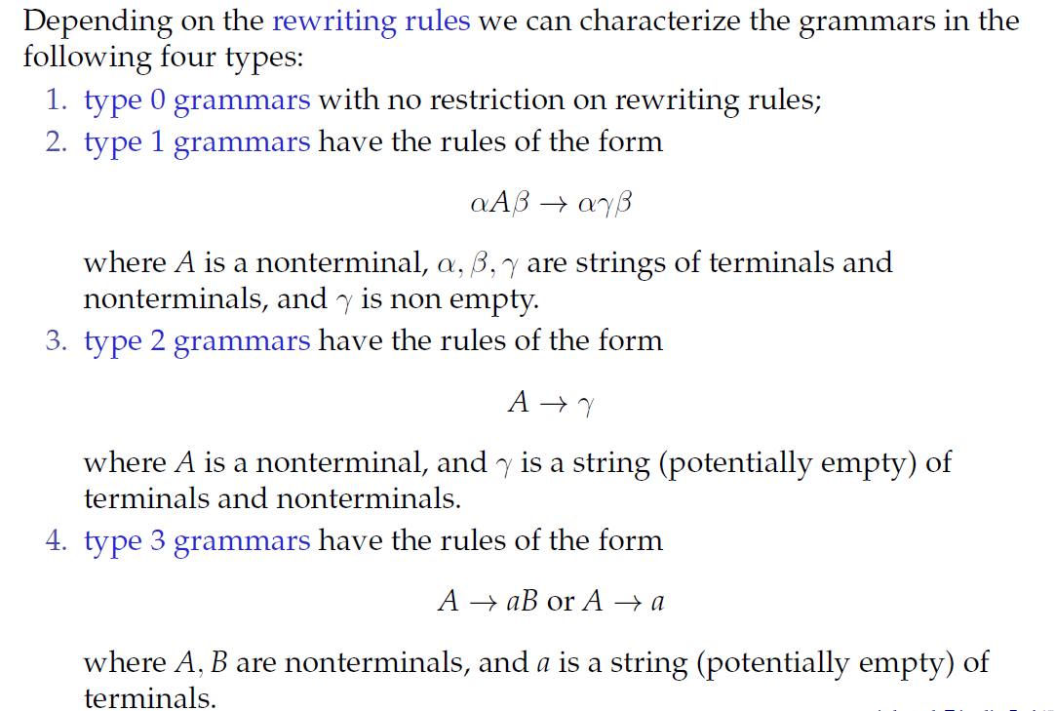
Types of Grammars

Slide 13
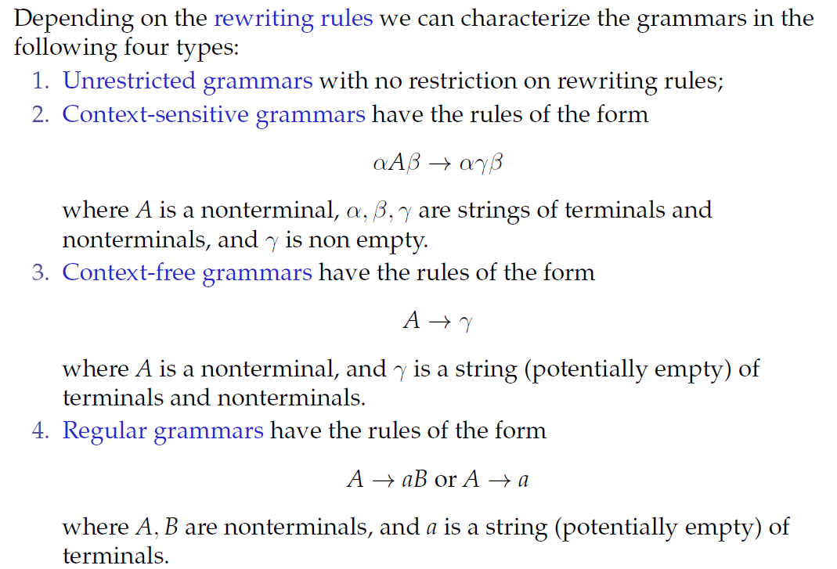
Types of Grammars (Continued)

Slide 14
Polling Questions
1. Which of the following strings is not generated by the following grammar?
S → SaSbS|ε
a) aabb
b) abab
c) aababb
d) aaabbb
Notes:
d

Slide 15
2. What is the highest type number which can be applied to the following grammar ?
S —> Aa, A —> Ba, B —> abc
A.Type 0
B.Type 1
C.Type 2
D.Type 3
Notes:
c

Slide 16
3. The context free grammar
S → A111|S1, A → A0 | 00 is equivalent to
a) {0ⁿ1ᵐ | n=2, m=3}
b) {0ⁿ1ᵐ | n=1, m=5}
c) {0ⁿ1ᵐ | n should be greater than two and m should be greater than four}
d) None of these
Notes:
a

Slide 17
1.The CFG
S---> aS | bS | a | b
is equivalent to regular expression
A.(a + b)
B.(a + b) (a + b)*
C.(a + b) (a + b)
D.None of these
Notes:
B

Slide 18
2. Consider the grammar :
S —> ABCc | Abc
BA —> AB
Bb —> bb
Ab —> ab
Aa —> aa
Which of the following sentences can be derived by this grammar :
A.abc
B.aab
C.abcc
D.abbb
Notes:
A

Slide 19
3. Any string of terminals that can be generated by the following CFG is
S-> XY
X--> aX | bX | a
Y-> Ya | Yb | a
A.has atleast one 'b‘
B.should end in a 'a‘
C.has no consecutive a's or b's
D.has atleast two a's
Notes:
D

Slide 20
POLLING QUESTIONS
The regular expression representing the set of all strings over {X, Y} ending with XX and beginning with Y is
XX ( X + Y )* Y
YY ( X + Y )* X
Y ( X + Y)* XX
Y (XY)* XX.
Notes:
C

Slide 21
2. Which of the following grammars generates strings with any number of 1’s?
S ->1A, A -> ε
S -> 1S, S -> ε
S -> S1, S ->ε
Both B) and C)
Notes:
A

Slide 22
3. Consider the grammar:
S -> aSAb | ε; A -> bA | ε;
The grammar generates strings in the form a^ib^j for some i, j >=0. What are the conditions for i & j?
i = j
j <= 2i
j >= 2i
i <= j
Notes:
C,D

Slide 23
4. The string 1101 does not belong to the set represented by
110*(0+1)
1(0+1)*101
(10)*(01)*(00+11)*
(00+(11)*01)*
Notes:
C

Slide 24
5. The following CFG:
S -> aB | bA
A -> b | aS | Baa
B-> a | bS | aBB
generates strings that have:
Equal number of a’s and b’s
Odd number of a’s and odd number of b’s
Even number of a’s and even number of b’s
None of the above
Notes:
d

Slide 25
6. Consider the Grammar, G, with the production rule:
S ->SS | SaS | aSb | bSa | ε
If S is the Start Variable, then which of the following is not generated by G?
abab
aaab
abbaa
babba
Notes:
d

